Slide 1

MnDOT Customer Survey
March 2017 Summary Data
Public Engagement & Constituent Services Office

Slide 2
42
Total Responses
Date Created: Monday, February 27, 2017
Complete Responses: 35

Slide 3
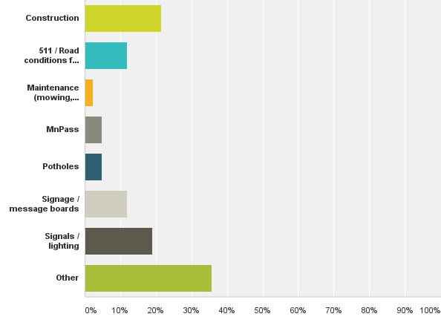
Q1: What was the main topic of your question, concern or comment? (Select all that apply.)
Answered: 42 Skipped: 0
Notes:
Other:
Corner of Hwy 33 and Int 35 Cloquet property that our Family owns that
total road deterioration
Conditions of roads during and after inclement/snowy/icy weather.
unsightly abandoned-buildings, delayed-removal.
Signage in advance to notify ramp closure
Offering Energy Savings
quarter line change in douglas county mn in2001
Looking for video on one of the cameras
stolen license platet
vehicle compliance
Dot inspector questions for commission
Developer API
site specific roadway restrictions
Certifcation
Lack of proper plowing and treatment
Intersection of 95 & flink & falcon Ave. speed limit by Wildridge development. Should be 40 mph. That doesn't happen until u get closer to 95. Too fast

Slide 4
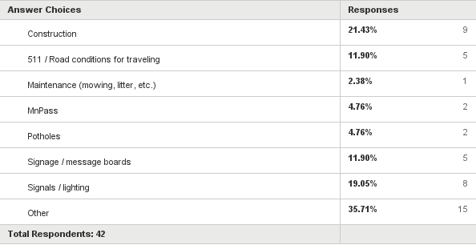
Q1: What was the main topic of your question, concern or comment? (Select all that apply.)
Answered: 42 Skipped: 0

Slide 5
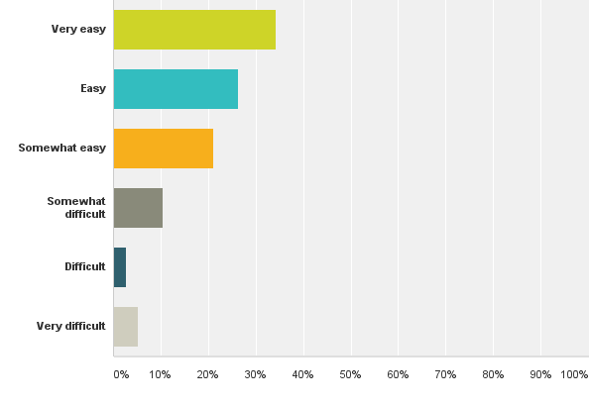
Q2: How easy or difficult was it for you to find a way to contact MnDOT?
Answered: 38 Skipped: 4

Slide 6
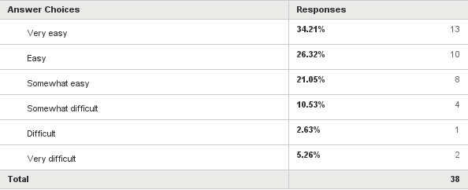
Q2: How easy or difficult was it for you to find a way to contact MnDOT?
Answered: 38 Skipped: 4

Slide 7
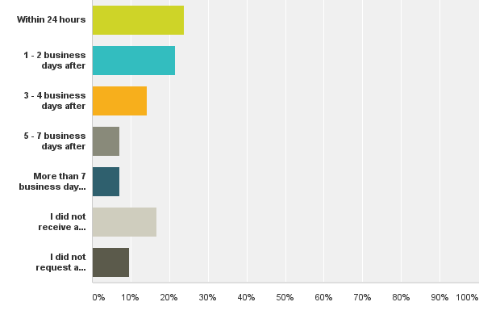
Q3: How soon did you receive a response after you submitted your question, concern or comment ?
Answered: 42 Skipped: 0

Slide 8
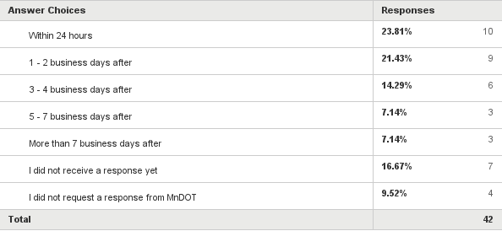
Q3: How soon did you receive a response after you submitted your question, concern or comment ?
Answered: 42 Skipped: 0

Slide 9
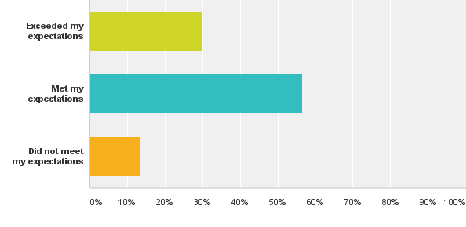
Q4: How well did the response time meet your expectations?
Answered: 30 Skipped: 12

Slide 10
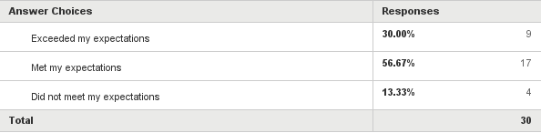
Q4: How well did the response time meet your expectations?
Answered: 30 Skipped: 12

Slide 11
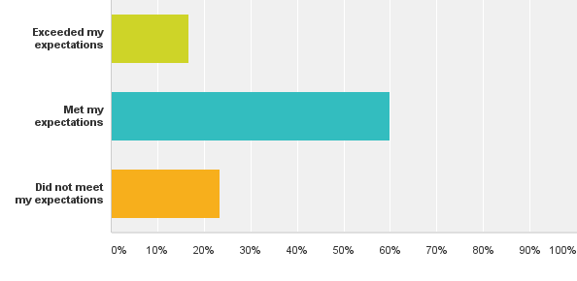
Q5: How well did the response answer or address your question, concern or comment?
Answered: 30 Skipped: 12

Slide 12

Q5: How well did the response answer or address your question, concern or comment?
Answered: 30 Skipped: 12

Slide 13
Q6. If you selected "did not meet my expectations" for any of the questions above, please tell us more so we can improve our service to customers. (representative responses)
Make sure the main highways are cleared and treated before rush hour traffic. So many times this winter, traffic was very slow due to road conditions.
One day I heard a MNDOT person on the news say "if you can stay home or work from home, you should". I suggested that it would be nice for MNDOT to make a call like that during snow (or rain I guess) events. I received a timely response that just directed me to the traffic map.
I only received this Survey Monkey questionnaire. I never received a response to my original question/comment/complaint on the road conditions or lack of having the roads safe for travel.

Slide 14
Q7. If you selected "exceeded my expectations" for any of the questions above, please tell us more so we know what to continue doing to exceed customer expectations! (representative responses)
I had a question about a proposed change in an intersection, and fortunately for me, the proposed change was scrapped as that was the best decision in my opinion.
I received a personal response that explained exactly why the sign wasn't lit (in error) and assured me it will be in the future.... and it has! Thank you
IT WAS JUST A VERY TIMELY RESPONSE, BETTER THAN I EXPECTED CONSIDERING MNDOT MUST RECEIVE MANY AND FROM A LOT OF DISGRUNTLED PEOPLE.
Responded quickly and answered my question thoroughly.
Simply did not expect such a quick response!

Slide 15
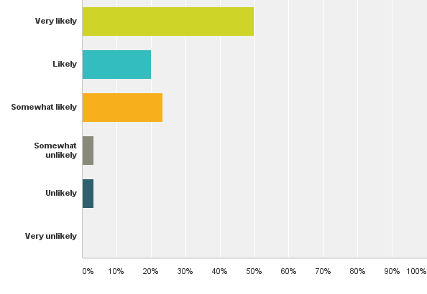
Q8: How likely would you be to contact MnDOT again with a question, concern or comment?
Answered: 30 Skipped: 12

Slide 16

Q8: How likely would you be to contact MnDOT again with a question, concern or comment?
Answered: 30 Skipped: 12

Slide 17
Q8: How likely would you be to contact MnDOT again with a question, concern or comment?
Answered: 30 Skipped: 12

Slide 18
Q8: How likely would you be to contact MnDOT again with a question, concern or comment?
Answered: 30 Skipped: 12

